Slide 1

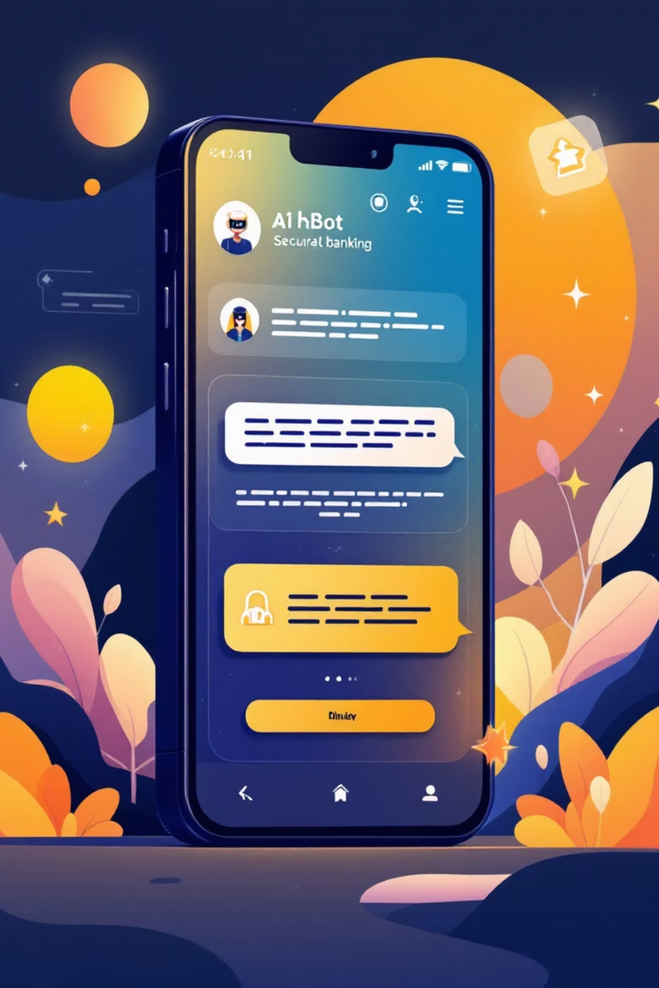

BankBot AI Chatbot for Banking FAQs
Batch-1:
Gandla Rupasree
Sreekakula Geethika
Yuvaraj

Slide 2

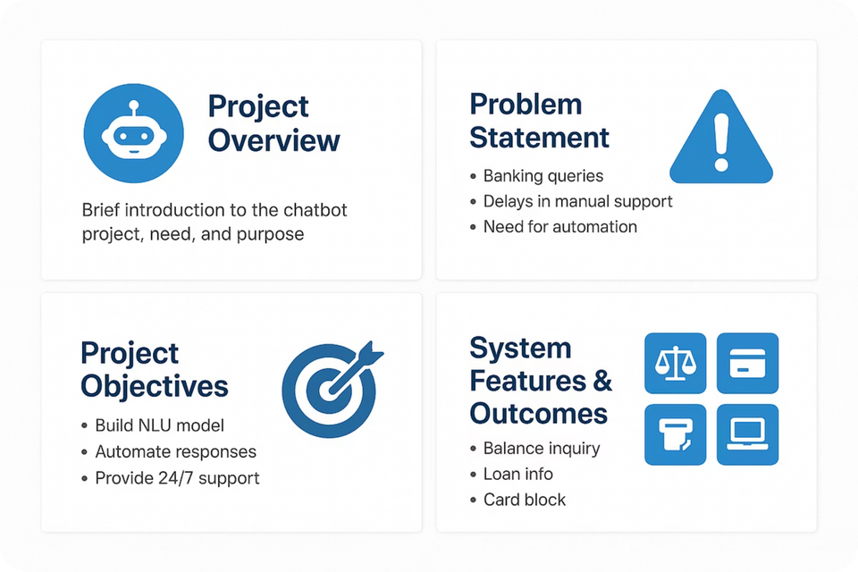
Project Statement: Intelligent Banking Chatbot
This project aims to develop an intelligent chatbot to address common banking queries, reducing manual customer service reliance and operational costs. It will combine rule-based and machine learning approaches for accuracy and scalability, accessible via web and potentially mobile apps.

Slide 3




Key Outcomes
24/7 AI Support
Intent Handling
AI-powered chatbot for continuous customer query resolution.
Handles balance checks, loan inquiries, card blocking, and branch location.
Interactive UI
Backend Management
Text-based web interface for common banking queries.
Role-based backend for training data and chatbot improvement.

Slide 4
Core Modules: Building Blocks of the Chatbot
01
02
03
Intent & Entity Recognition
Response & Dialogue Management
Web Interface & UI
Train NLU models to define intents (e.g., "Check Balance") and extract entities (e.g., account type, location).
Develop a responsive chat window with typing animation, response bubbles, and bank branding. Optional WhatsApp integration.
Manage conversations with rules, stories, context tracking, and fallback handling. Escalate to human agents when necessary.
04
05
Admin Panel & Training
Knowledge Base & API Integration
Enable admins to upload/edit intents, view user logs, and trigger model retraining with role-based login.
Connect to external APIs for real-time data and manage FAQs/static content via a local database or Firebase.

Slide 5
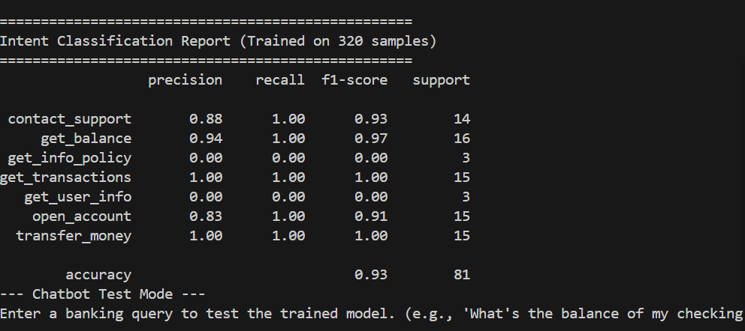
Milestone 1: Intent & Entity Recognition
Weeks 1–2 Focus
Define key intents and examples for banking queries.
Build and test NLU model using spaCy or Rasa NLU.
Implement entity extraction and slot filling logic.
This foundational module ensures the chatbot accurately understands user requests.

Slide 6
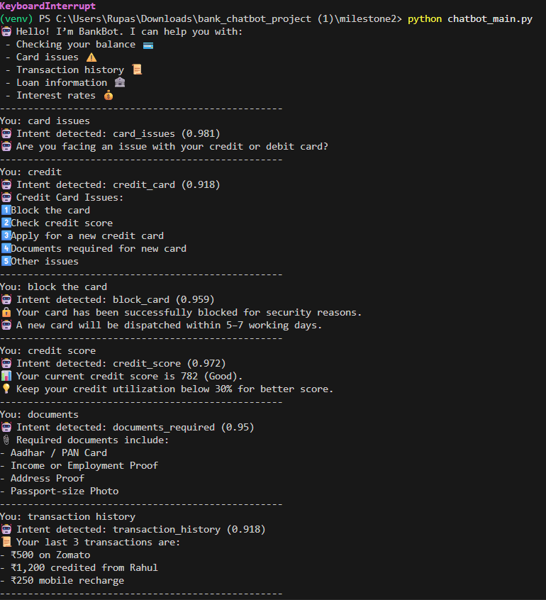
Milestone 2: Response Handling & Dialogue Flow
Weeks 3–4 Focus
Build conversation flows with rules and ML-based stories.
Implement fallback for unknown questions and chitchat handling.
Test sessions with diverse sample conversations.
This milestone ensures smooth and natural conversational interactions.

Slide 7
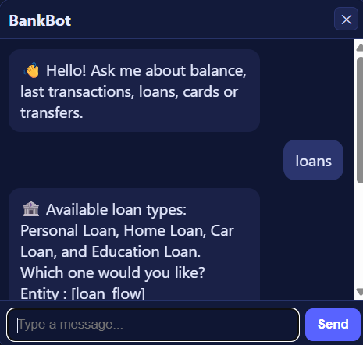
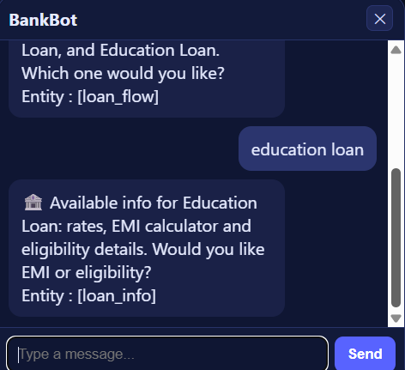
Milestone 3: UI Integration & Chat Interface
Weeks 5–6 Focus
Create a web-based chat interface using Flask/Streamlit/React.
Connect the frontend to the backend chatbot service.
Implement graceful error handling and edge case management in the UI.
This stage brings the chatbot to life with a user-friendly and responsive interface.

Slide 8
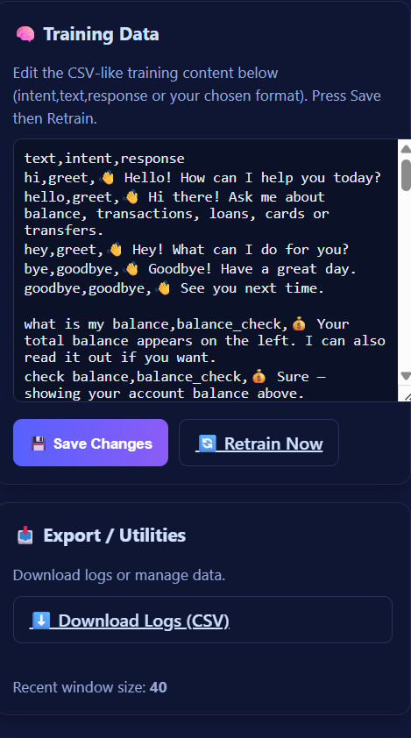
Milestone 4: Admin Panel & Knowledge Base
Weeks 7–8 Focus
Develop an admin panel for editing training data and viewing user queries.
Enable dynamic management of FAQs and question-answer pairs.
Implement model retraining triggers and analytics export (CSV).
This final module provides tools for continuous improvement and oversight.

Slide 9
Evaluation Criteria: Ensuring Success
1
2
Milestone 1 (Week 2)
Milestone 2 (Week 4)
Accurate identification of top 10 intents and entity extraction (amount, account type, dates).
Stable dialogue flow, graceful handling of unknown intents, and contextual query management.
3
4
Milestone 3 (Week 6)
Milestone 4 (Week 8)
Responsive and user-friendly UI, functional real-time connection, and robust error handling.
Admin ability to view logs, edit data, trigger retraining, and access analytics.

Slide 10
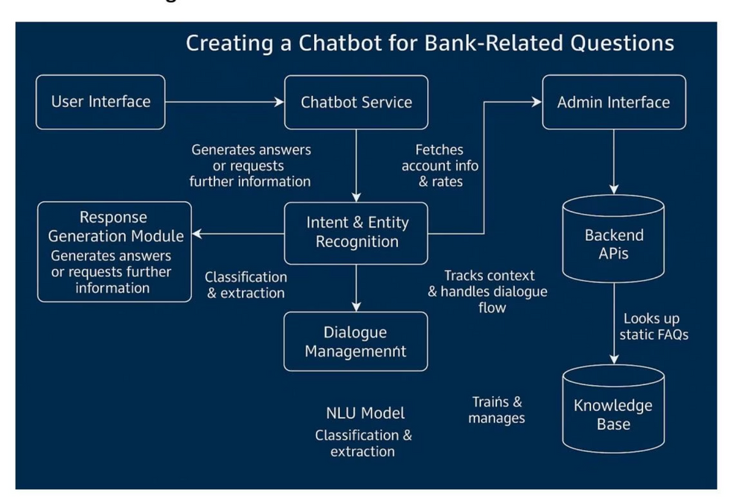
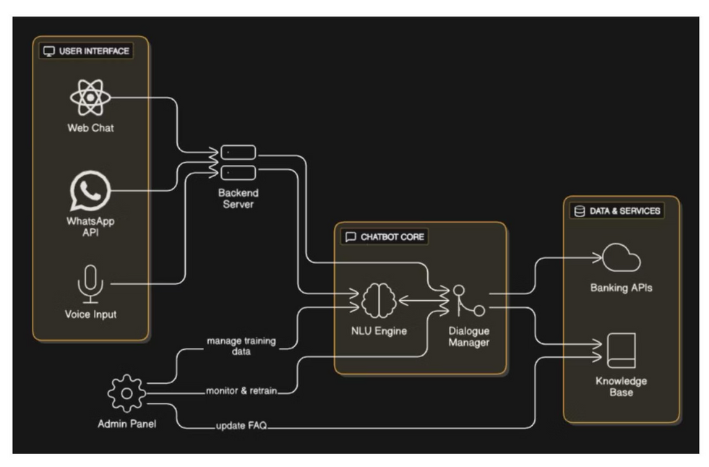
System Architecture & Workflow
The chatbot's robust architecture ensures seamless operation and data management.
Workflow Diagram
Architecture Diagram

Slide 11

CONCLUSION:
The banking chatbot successfully automates customer queries with real-time, accurate responses.It enhances user experience through natural conversation and 24/7 availability.The modular design ensures easy scalability, maintenance, and continuous improvement.Overall, the system provides an efficient, reliable, and modern solution for digital banking support.

Slide 12
Thank you

